Slide 2
LOGISTIC REGRESSION
Logistic regression is a supervised learning classification algorithm used to predict the probability of a target variable. ... It is one of the simplest ML algorithms that can be used for various classification problems such as spam detection, Diabetes prediction, cancer detection etc.

Slide 3
In logistic regression model the response variable is categorical.
The idea of logistic regression is relationship between feature(independent variable) and probability of particular outcome.
example: pass or fail, yes or no etc.

Slide 4
MARKS | RESULT
20 | FAIL
85 | PASS
65 | PASS
30 | FAIL
45 | PASS
25 | FAIL
95 | PASS

Slide 5
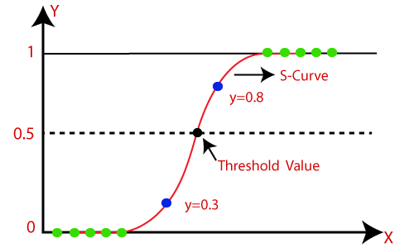

Slide 6
SIGMOID FUNCTION
The sigmoid function is a mathematical function used to map the predicted values to probabilities.
It maps any real value into another value within a range of 0 and 1.
The value of the logistic regression must be between 0 and 1, which cannot go beyond this limit, so it forms a curve like the "S" form. The S-form curve is called the Sigmoid function or the logistic function.
In logistic regression, we use the concept of the threshold value, which defines the probability of either 0 or 1. Such as values above the threshold value tends to 1, and a value below the threshold values tends to 0.

Slide 7
SIGMOID FUNCTION
logistic regression transforms its output using the logistic sigmoid function to return a probability value which can then be mapped to two or more discrete classes.
Y = 1 / 1+e ^{-z}
^{Z: Independent variable}
^{e: natural log}
^{e=2.718}

Slide 8
TYPES OF LOGISTIC REGRESSION MODEL
BINARY LOGISTIC REGRESSION
MULTINOMIAL LOGISTIC REGRESSION
ORDINAL LOGISTIC REGRESSION

Slide 9
On the basis of the categories, Logistic Regression can be classified into three types:
Binomial: In binomial Logistic regression, there can be only two possible types of the dependent variables, such as 0 or 1, Pass or Fail, etc.
Multinomial: In multinomial Logistic regression, there can be 3 or more possible unordered types of the dependent variable, such as "cat", "dogs", or "sheep"
Ordinal: In ordinal Logistic regression, there can be 3 or more possible ordered types of dependent variables, such as "low", "Medium", or "High".

Slide 10
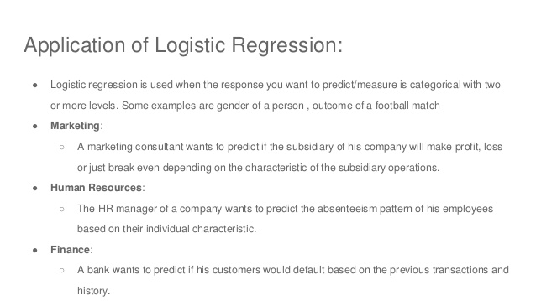

Slide 11
LOGISTIC REGRESSION FOR CLASSIFICATION
Logistic Regression is much similar to the Linear Regression except that how they are used. Linear Regression is used for solving Regression problems, whereas Logistic regression is used for solving the classification problems.
In Logistic regression, instead of fitting a regression line, we fit an "S" shaped logistic function, which predicts two maximum values (0 or 1).
The curve from the logistic function indicates the likelihood of something such as whether the cells are cancerous or not, a mouse is obese or not based on its weight, etc.
Response variable in logistic regression is categorical while in linear regression it is continuous.

